Slide 1
CSE202: Introduction to Formal Languages and Automata Theory
Chapter 9
The Turing Machine
These class notes are based on material from our textbook, An Introduction to Formal Languages and Automata, 4th ed., by Peter Linz.

Slide 2
Automata
A Finite Automaton has only its states to serve as memory - very limited in what languages it could recognize
In a Pushdown Automaton we added a stack to a Finite Automaton - this gave it better memory, and allowed it to recognize more languages. But it was still limited by the nature of the stack.
We could add another stack to a Pushdown Automaton. This would allow it to accept some non-context free languages (e.g., a^{n}b^{n}c^{n}).
Or we could change the stack to a queue. This would allow other languages to be accepted (e.g., ww).

Slide 3
All of the automata we study in this class have a
finite number of states.
They differ in the “auxiliary memory” they have and
how it is organized.
DFA
NFA
DPDA
PDA
Turing machine
finite memory
infinite stack memory
infinite tape memory
(tape can be read forwards and
backwards without erasing)

Slide 4
Hierarchy of automata
DTM, NTM
LBA
PDA
DPDA
DFA,
NFA

Slide 5
The Turing Machine
Alan Mathison Turing, b. 1912, d. 1954. Contributed much to the foundations of computing theory.
Published the Turing machine model in 1937.
Church-Turing Thesis - “Any algorithmic procedure that can be carried out by a human, a team of humans, or a machine can be carried out by some Turing machine.”
Unproveable, because we don’t have a precise definition of what “algorithmic procedure” means, but generally accepted as true.
Puts a limit on what can be computed.

Slide 6
The Church-Turing Thesis
No model of digital computation is more powerful than a Turing machine.
By “more powerful,” we mean “can recognize languages that a TM cannot recognize.”
This is not something that can be proved. But everybody believes it because no one has been able to devise a more powerful model of computation.

Slide 7
Definition: Turing Machine
A Turing machine (TM) is a 7-Tuple
T = (Q, Σ, Γ, δ, q₀, Δ, F), where
  Q = a finite set of states not containing h (the halt state)
  Σ = a finite set of symbols constituting the input alphabet;
  Σ ⊆ Γ – {Δ}
  Γ = a finite set of symbols constituting the tape alphabet
  δ = the transition function: Q × Γ → Q × Γ × {L, R}
  q₀ = the start state (q₀ ∈ Q)
  Δ is a special symbol, the blank symbol
  F ⊆ Q is the set of final states

Slide 8
Definition: Turing Machine
Turing machines can be thought of as a finite state automaton with slightly different labels on the arcs, plus a tape as auxiliary memory, and a tape head (or read-write head).
Δ | 1 | 0 | 0 | 1 | Δ | Δ

Slide 9
Definition: Turing Machine
The tape on a Turing machine can be thought of as a linear structure marked off into squares or cells. It is usually defined as infinite in both directions, but may be thought of as bounded on the left side, but infinite on the right. Each cell on the tape on a Turing machine can hold a symbol from the input alphabet, a symbol from the tape alphabet (which may include some symbols which are not in the input alphabet), or a blank symbol Δ which is distinct from the input alphabet.

Slide 10
Standard Turing Machine
The standard Turing machine described by our textbook has several features:
The TM has a tape that is unbounded in both directions.
The TM is deterministic in the sense that δ defines at most one move per configuration
There is no special input file; the input is copied onto the tape.
There is no special output device; the tape contains the output, if any.

Slide 11
The TM tape head
The Turing machine has a tape head which reads from and writes to the tape during each move.
The tape head can move right or left, or may stay in the same position.
The tape head can read a character from the cell under which it is positioned, or it may write a character to the cell.

Slide 12
The TM transition function
The TM transition function has the following form:
δ(q, X) = (r, Y, D)
This says that when the TM is in state q, and the read-write head reads a certain symbol (X) off the tape, then the TM will change state to state r, write a Y onto the tape, and move in direction D.
For example, δ(q₁, b) = (q₂, Δ, R) means: “We are currently in state q₁; read the cell; it’s a b. OK, change state to q₂, write a blank, and move right.”b

Slide 13
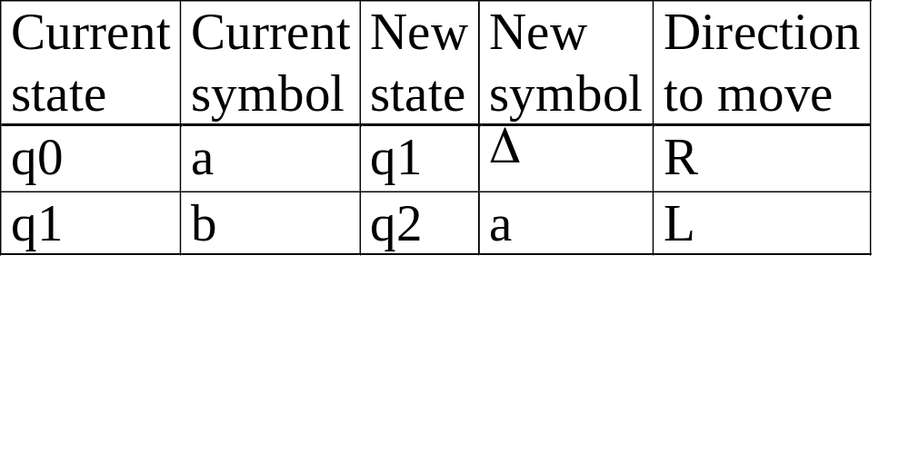
The TM transition function
The TM transition function can be represented in the form of a table:

Slide 14
TM transition function
We can label the arcs of a finite state machine to indicate the moves of the TM:
Δ / Δ, R
q₀
q₁
Δ | a | b | a | Δ | Δ | Δ

Slide 15
Processing a string
To process a string, we place the string onto the tape, where it can be read by the read-write head, surrounded by blank symbols on the left and right ends of the input. Once the string is on the tape, then processing can begin. We don’t need a separate input string after that.

Slide 16
Accepting a string
There is only one way that a string may be accepted by a TM: If a move causes the machine to move into an accepting halt state, then we stop and accept the string. (There are no moves out of a halt state.)
This may occur even when we haven’t finished processing the string yet.
For example, if our TM is processing all the strings that have aabb in them somewhere, the TM may halt after processing the 6th character of this string:
bbaabbaaaabbbb

Slide 17
Accepting a string
If T = (Q, Σ, Γ, δ, q₀, Δ, F) is a Turing machine, and w ∈ Σ⁺, w is accepted by T if, starting in the initial configuration corresponding to input w, T eventually enters a final acceptance state and halts.
In other words, w is accepted if there exists y and z ∈Γ* so that
q₀w |-_{T}* yq_{f}z, for some q_{f} ∈F
In this situation, we say that T halts on input w.
The language accepted by T is the set L(T) of input strings on which T halts.

Slide 18
Crashing and Halting
There are 2 ways a string may fail to be accepted by a TM:
Crashing
  If a symbol is found on the tape for which the transition function is undefined, and the current state is not the accepting halt state, then we crash.
  If our TM has a bounded left end, and a move is specified which causes the machine to move off of the left end of the tape, then we crash.
Looping
  If an input string causes the TM to enter an infinite loop, then we loop forever.
If the TM crashes, the string is explicitly rejected.

Slide 19
Exercises
Design a TM that accepts L = {a^{n}b^{n} | n ≥ 1}
To do this, we can construct the transition table for the TM. We can use a matrix as a short-hand representation:

Slide 20
{a^{n}b^{n} | n ≥ 1}
 | a | b | x | y | Δ
→q₀ | q₁,x,R |  |  | q₃,y,R
q₁ | q₁,a,R | q₂,y,L |  | q₁,y,R
q₂ | q₂,a,L |  | q₀,x,R | q₂,y,L
q₃ |  |  |  | q₃,y,R | q₄,Δ,R
q₄

Slide 21
{a^{n}b^{n} | n ≥ 1}
Replace leftmost a with an x and find the first b and replace with a y:
δ(q₀,a)=(q₁,x,R) δ(q₁,y)=(q₁,y,R)
δ(q₁,a)=(q₁,a,R) δ(q₁,b)=(q₂,y,L)
Come back to the next left-most a:
δ(q₂,y)=(q₂,y,L) δ(q₂,x)=(q₀,x,R)
δ(q₂,a)=(q₂,a,L)
Finally, check to see if all input has been processed and the a’s and b’s balance (and a’s precede the b’s):
δ(q₀,y)= (q₃,y,R) δ(q₃, Δ) = (q₄, Δ,R)
δ(q₃,y) = (q₃,y,R)

Slide 22
Exercises
Work through the processing of the string w = aaabbb in class.
Is this string accepted by the TM?
Work through the processing of the string w = aaabb.
Is this string accepted by the TM?
How does the TM reject the string?

Slide 23
Exercises
Recall that the following languages are not context-free.
  {a^{n}b^{n}c^{n} | n ≥ 0}
  {ww | w ∈ {a,b}*}
In English, describe how a Turing machine could accept each of these languages
Try to draw the transition diagrams for the Turing machines

Slide 24
{a^{n}b^{n}c^{n} | n ≥ 1}
 | a | b | c | x | y | z | Δ
→q₀ | q_{1,}x,R |  |  |  | q_{4,}y,R
q₁ | q_{1,}a,R | q_{2,}y,R |  |  | q_{1,}y,R
q₂ |  | q_{2,}b,R | q_{3,}z,L |  |  | q_{2,}z,R
q₃ | q_{3,}a,L | q_{3,}b,L |  | q_{0,}x,R | q_{3,}y,L | q_{3,}z,L
q₄ |  |  |  |  | q_{4,}y,R | q_{4,}z,R | q_{4,}Δ,R
q₅

Slide 25
Homework Suggestions
P. 236-237 2, 3, 5, 7(a,b)

